Slide 1

ENV 107
Introduction to
Environmental Science
Air Pollution
North South University

Slide 2
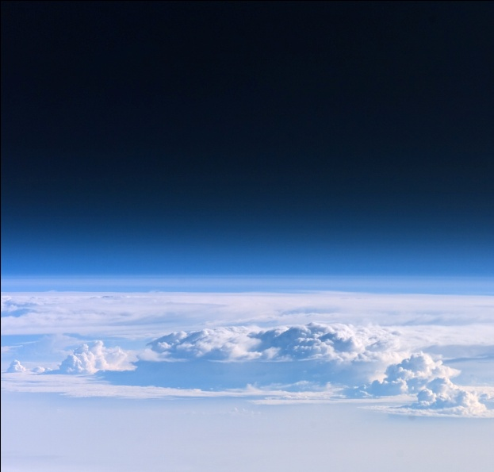
Atmosphere
Atmosphere of the earth refers to the layer of air that surrounds the solid crust of the earth.
It extents as far as 1600 kilometers above the surface of earth.
The atmosphere is made of gasses such as oxygen, hydrogen, water vapor, ozone, and the wind.
Composition of Atmosphere:
= 78% Nitrogen + 21% Oxygen + 0.9% Argon + 0.03% Carbon dioxide

Slide 3
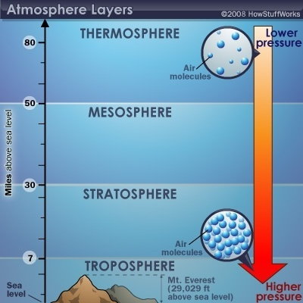
Layers of Atmosphere
Layers of Atmosphere
Thermosphere: 80 to 700 km (50 to 440 miles)
Mesosphere: 50 to 80 km (31 to 50 miles)
Stratosphere: 12 to 50 km (7 to 31 miles)
Troposphere: 0 to 12 km (0 to 7 miles)

Slide 4
Air Pollution
Air pollution may be defined as any atmospheric condition in which certain substances are present in such concentrations that they can produce undesirable effects on man and his environment
These substances include
  Gases: sulfur oxides, nitrogen oxides, carbon monoxide, hydrocarbons etc.
  Particulate matter: smoke, dust, fumes, aerosols
  Radioactive materials and many others
Most of these substances are naturally present in the atmosphere in low concentrations and are usually considered to be harmless

Slide 5
Sources of air pollution
Sources of air pollution are grouped into two major categories:
Stationary sources
  Those that have a relatively fixed location
Mobile sources
  Move from place to place while emitting pollutants
  These include automobiles, trucks, buses, ships and trains

Slide 6
Stationary sources
Include:
Point sources: emit pollutants from one or more controllable sites e.g. smokestacks of power plants
Fugitive sources: generate air pollutants from open areas exposed to wind processes e.g. burning for agricultural purposes, dirt roads, surface mines and other exposed areas from which particulates may be removed by wind
Area sources: well-defined areas within which are several sources of air pollutants e.g. small urban communities and areas of intense industrialization within urban complexes

Slide 7
Sources of Air Pollution
Natural:
natural gas emission, discharge during storm, pollens, microorganisms etc.
B. Man made:
Transportation - motor vehicle, aircraft, railway engines, etc.
Industrial - mainly petroleum. steel, paper industries , power plants mining operations.
Agriculture - Pesticides, herbicides, agricultural burning, etc.
Other - Solid waste, forest fires, nuclear explosion,

Slide 8
Contribution of Pollutants in the Atmosphere
      Carbon monoxide - 48%
      Nitrogen oxides - 8%
      Hydro carbons - 15%
      Sulfur dioxides - 15%
      Particulate - 14%

Slide 9
Primary Pollutants
Primary pollutants: emitted directly from the sources
Typical pollutants included under this category are:
  Particulate matter such as ash, smoke, dust, fumes, mist and spray
  Inorganic gases such as sulfur dioxide, hydrogen sulfide, nitric oxide, ammonia, carbon monoxide, carbon dioxide and hydrogen fluoride
  Olefinic and aromatic hydrocarbons
  Radioactive compounds

Slide 10
Primary Pollutants
Of the large number of primary pollutants emitted into the atmosphere, only a few are present in sufficient concentrations to be of immediate concern
These are the five major types - particulate matter, sulfur oxides, oxides of nitrogen, carbon monoxide and hydrocarbons
Carbon dioxide is generally not considered an air pollutant, but because of its increased global concentration its influence on global climatic patterns is of great concern

Slide 11
Major Primary Pollutants
Sulfur oxides (SOx) - especially sulfur dioxide
Nitrogen oxides (NOx) - especially nitrogen dioxide are emitted from high temperature combustion.
Carbon monoxide - is a colourless, odourless, non-irritating but very poisonous gas.
Carbon dioxide (CO2) - a greenhouse gas
Volatile organic compounds - VOCs are an important outdoor air pollutant
Particulate matter - Particulates, alternatively referred to as particulate matter (PM) or fine particles, are tiny particles of solid or liquid suspended in a gas.

Slide 12
Major Primary Pollutants
Toxic metals, such as lead, cadmium and copper
Chlorofluorocarbons (CFCs) - harmful to the ozone layer
Ammonia (NH₃) - emitted from agricultural processes
Odors — such as from garbage, sewage, and industrial processes
Radioactive pollutants - produced by nuclear explosions, war explosives, and natural processes such as the radioactive decay of radon.

Slide 13
Secondary pollutants
Secondary pollutants: formed in the atmosphere by chemical interactions among primary pollutants and normal atmospheric constituents
Reaction mechanisms and various steps involved in the process are influenced by many factors i.e.
  Concentration of reactants
  Amount of moisture present in the atmosphere
  Degree of photo activation
  Meteorological forces
  Local topography

Slide 14
Secondary pollutants
Pollutants included in this category are:
  Sulfur trioxide
  Nitrogen dioxide
  PAN (peroxyacetyl nitrate)
  Ozone
  Aldehydes
  Ketones
  Various sulfate and nitrate salts

Slide 15
Criteria Air Pollutants
Emitted from many large diverse sources, including mobile and stationary sources
Pose the greatest overall threat to human health
Assumption: the adverse health effects are not cancerous and they exhibits a threshold does-response
The 6 Criteria Air Pollutants are:
  Sulfur dioxide
  Nitrogen oxides
  Carbon monoxide
  Ozone and other photochemical oxidants
  Particulate matters (PM₁₀, PM_{2.5} and ultrafine)
  Lead

Slide 16
Sources of Criteria Air Pollutants
Sulfur dioxide:
Combustion of coal, oil, and other sulfur containing fuels; petroleum refining, metal smelting, paper making.
Particulate matter:
Fuel combustion, industrial processes, construction, forest fires, refuse incineration, automobile traffic.
Nitrogen dioxide:
Produced by combinations of atmospheric nitrogen and oxygen at high combustion temperatures such as those in automobile engines; also a by- product in the manufacturing of fertilizers.

Slide 17
Sources of Criteria Air Pollutants
Volatile organic Compounds:
Motor vehicles - evaporation from gasoline tanks and carburetors; industrial processes involving solvents.
Carbon monoxide :
Combustion of fuel, e.g. gasoline.
Lead:
Combustion of leaded gasoline; solder, lead-containing paint; lead-smelting operations.
Photochemical oxidants:
Produced via complex photochemical reactions in the atmosphere involving hydrocarbons, nitrogen dioxide, and sunlight.

Slide 18
Stratospheric Ozone
Ozone layer in the stratosphere is often called the ozone shield, because it absorbs approximately 99% ultraviolet (UV) radiation that is potentially damaging to life
Approximately 90% of the Ozone in the atmosphere is found in the stratosphere
As Ozone absorbs ultraviolet radiation in the stratosphere, it breaks down into an Oxygen molecule and an Oxygen atom. Oxygen atom and molecules may react again and form new Ozone

Slide 19
Ozone Layer Depletion
Major compounds in Ozone depletion consists of CFC compounds, commonly known as “Freons”
Freons react with Ozone and destroy them
Freons are used in refrigerants, aerosol spray propellants, industrial solvents, cleaning fluids etc
Mario Molina and Sherwood Rowland in 1974 discovered that CFCs could catalyze the destruction of stratospheric Ozone – earned them Nobel prize in 1995

Slide 20
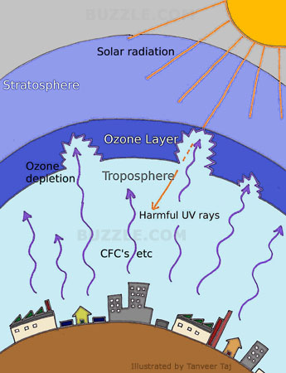
Ozone Layer Depletion
Fig: Greenhouse effect (Source: Buzzle)

Slide 21
Indoor Air Pollution
Human kind faces the most prolonged and worst exposure to pollution within the four walls of home
Indoor air pollution can have an astonishing variety of sources incl. cooking gas, heaters, fire places, wood or coal burning stoves, cigarette smoking, household products like detergents, waxes, polishes, air fresheners, pesticides, glues, paints, hair sprays, oven cleaners, permanent press fabrics, synthetic fibers and cleaning activities like dusting and vacuum cleaning
And whatever pollutes the outside air eventually becomes indoor pollution as well, especially in older leaky buildings

Slide 22
Indoor Air Pollution
Four most dangerous indoor air pollutants
  Tobacco smoke- most preventable
  Formaldehyde
    Found in many building material, and household products (plywood, particle board, paneling, high-gloss wood, drapes, furniture, carpets, wallpaper, wrinkle- free coating on permanent –press clothing)
    The chemical that causes most people in developed countries difficulty
    Colorless extremely irritating chemical
    Causes chronic breathing problems, dizziness, skin, eye, sinus irritation, rash, headaches, sore throats, wheezing and nausea
    EPA estimates that 1 of every 5,000 people who live in manufactured homes for more than 10 years will develop cancer from formaldehyde exposure.

Slide 23
Indoor Air Pollution
  Radioactive radon-222 gas
    Seep into houses from underground rock deposits
    Colorless odorless radioactive gas produced by the natural decay of uranium-238.
    lung tissue damage, lung cancer
    Estimated that 7,000 to 30,000 Americans die each year from radon-induced lung cancer
    Only smoking causes more lung cancer deaths
    Smokers more at risk than non-smokers
  Very small particles
    Asbestos
    Irritate the nose and throat, damage the lungs, aggravate asthma and bronchitis, and shorten life.

Slide 24
Indoor Air Pollution
Other possible indoor air pollutants
  Pesticide residue
  Pb particles
  Living organisms and their excrements
    E.g., Dust mites and cockroach droppings
  Airborne spores of molds and mildews

Slide 25
Factors Increase Indoor Air Pollution
construction of more tightly sealed buildings,
increased insulation and reduce ventilation
use of synthetic buildings materials and
furnishings,
use of chemically formulated personal care
products, pesticides, in-house cleaners,
use of fuel for cooking, tobacco smoke,

Slide 26
Indoor Air Pollution
Who are at greatest risk from indoor air pollution?
  Children under 5 and the elderly
  Sick
  Pregnant women
  People with respiratory disorders or heart problems
  Smokers
  Factory workers

Slide 27
Indoor Air Pollution
Six major categories of ill health can be attributed to indoor exposures
  Acute respiratory infections (ARI) in children
  Adverse pregnancy outcomes for women exposed during pregnancy
  Chronic lung ailments (bronchitis and asthma), associated heart maladies and lung cancer
  Diseases of the eyes
  Increase in the severity of coronary artery disease

Slide 28
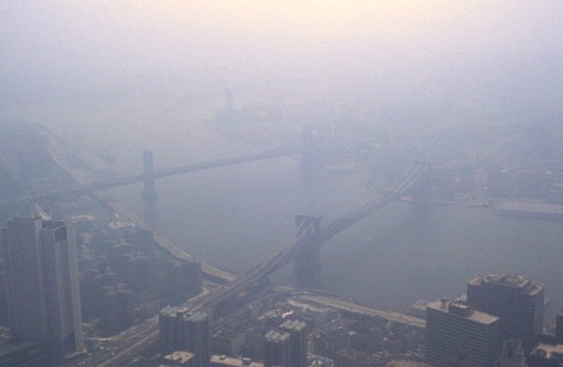
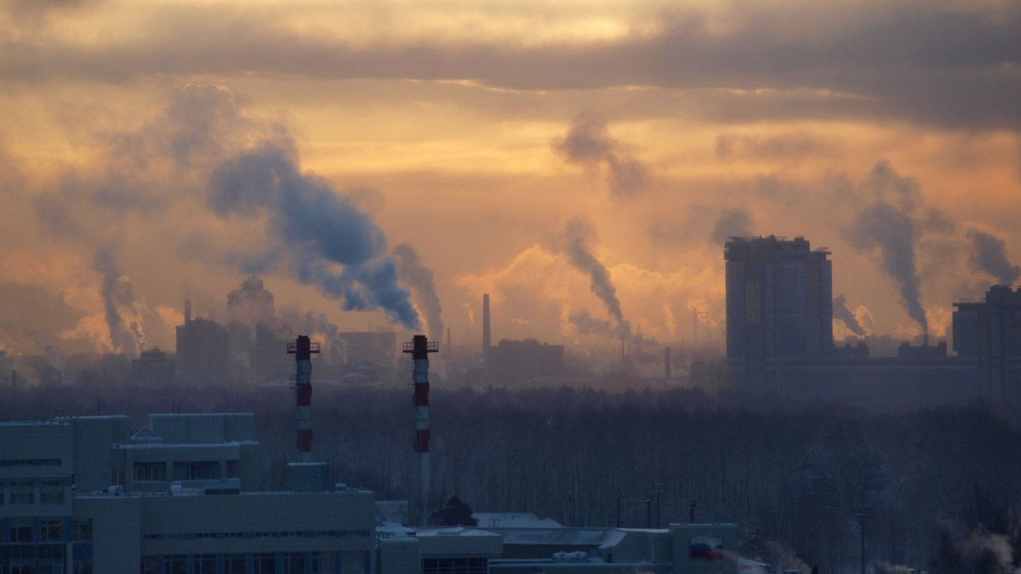
Smog
Smog is often used as a generic term for any kind of air pollution that reduces visibility, especially in urban areas.
Smog = Smoke + Fog
Two broad types of Smog:
industrial smog and photochemical smog.

Slide 29
Photochemical Smog
Any chemical reaction activated by light is called a photochemical reaction
photochemical smog is a mixture of primary and secondary pollutants formed under the influence of sunlight
The resulting mixture of more than 100 chemicals is dominated by photochemical ozone, a highly reactive gas that harms most living organisms

Slide 30
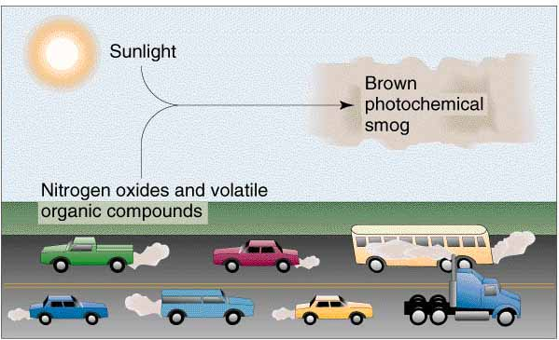
Photochemical Smog
Fig: Photochemical Smog formation (Source: Schoolworkhelper)

Slide 31
Photochemical Smog
The chemistry of photochemical smog formation is as follows:
It begins when nitrogen and oxygen in air react at the high temperatures found inside automobile engines and the boilers in coal-burning power and industrial plants to produce colorless nitric oxide
Once in the troposphere, the nitric oxide slowly reacts with oxygen to form nitrogen dioxide, a yellowish-brown gas with a choking odor
The NO is responsible for the brownish haze that hangs over many cities during the afternoons of sunny days
  photochemical smog sometimes is called brown-air smog

Slide 32
Industrial Smog
Fifty years ago, cities i.e. London, England; and Chicago and Pittsburgh in the USA used to burn large quantities of coal and heavy oil (which contain sulfur impurities) in power plants, factories and for heating
During winter, people in those cities were exposed to Industrial smog consisting mostly of
  sulfur dioxide
  suspended droplets of sulfuric acid (formed from sulfur dioxide)
  a variety of suspended solid particles and droplets (called aerosols)

Slide 33
Chemistry of Industrial Smog
When burned, carbon in coal and oil is converted to carbon dioxide and carbon monoxide
Some of the unburned carbon also ends up in the atmosphere as suspended particulate matter (soot)
The sulfur compounds in coal and oil also react with oxygen to produce sulfur dioxide, a colorless, suffocating gas
In the troposphere, some of the sulfur dioxide react with oxygen to form sulfur trioxide, which then react with water vapor in the air to produce tiny suspended droplets of sulfuric acid
Some of these droplets react with ammonia in the atmosphere to form solid particles of ammonium sulfate
Tiny suspended particles of such salts and carbon (soot) give the resulting industrial smog a gray color, explaining why it is sometimes called gray­ air smog

Slide 34
Industrial Smog
Industrial smog is rarely a problem today in most developed countries because coal and heavy oil are burned only with reasonably good pollution control
However, industrial smog is a problem in China, India, Ukraine and some eastern European countries where large quantities of coal are burned with inadequate pollution controls
According to UN, 13 of the world's 15 cities with worst air pollution are found in Asia (10 of them in China)-mostly from burning coal and leaded gasoline

Slide 35
Acid Rain
Acid rain encompasses both wet (rain, snow, fog) and dry (particulate) acidic depositions that occur near and downwind of areas where major emissions of sulfur dioxide (SO2) and nitrogen oxides (NOx) result from burning fossil fuels.
Pure rainfall has a pH of about 5.6 where 1 is highly acid and 7 is neutral. Acid rain is defined as precipitation in which the pH is below 5.6

Slide 36

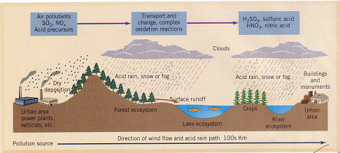
Acid Rain

Slide 37
Effects of Acid rain
Acid rain has many harmful effects when pH falls below 6 and especially 5:
Contributes to human respiratory diseases such as bronchitis and asthma
Can leach toxic metals such as lead and copper from water pipes into drinking water.
Damages statues, buildings, metals and cars. Limestone and marble are especially susceptible because they dissolve even in weak acid solutions
Can lower profits and cause job losses because of lower productivity in fisheries, forests and farms

Slide 38
Effects of Acid rain
Decreases atmospheric visibility
Loss of essentially all fish populations below a pH of 4.5
Release of ions attached to minerals in nearby soil into lakes
Damaging leaves directly
Reduces plant productivity and the ability of the soils to buffer or neutralize acidic inputs
Promoting the growth of acid-loving mosses that can kill trees
Weaken trees and other plants so they become more susceptible to various types of damage

Slide 39
Effects of Air Pollution
Affects health of human beings and animals
Damages vegetation and soils
Deteriorates materials
Affects climate
Reduces visibility
Some effects are specific and measurable, i.e. damages to vegetation and material and reduced visibility; but most are difficult to measure, i.e. health effects on human beings and animals and interference with comfortable living

Slide 40
Health Effect of Air Pollution
Short-term effects:
Irritation to the eyes, nose and throat,
upper respiratory infections such as bronchitis and pneumonia.
Other symptoms can include headaches, nausea, and allergic reactions.
Short-term air pollution can aggravate the medical conditions of individuals with asthma and emphysema.

Slide 41
Health Effect of Air Pollution
Long-term health effects
Chronic respiratory disease, lung cancer, heart disease, and even damage to the brain, nerves, liver, or kidneys.
Continual exposure to air pollution affects the lungs of growing children and may aggravate or complicate medical conditions in the elderly.
It is estimated that half a million people die prematurely every year in the United States as a result of smoking cigarettes.

Slide 42
Prevention and Control of Air Pollution
The control of air pollution is ultimately an engineering problem. Recommended procedures include:
Containment: prevention of escape of toxic substances into the air
Replacement: replacing a technological process which causes air pollution by a new process that does not
Dilution: Dilution is valid so long as it is within the self-cleaning capacity of the environment
Legislation: Many countries have effective legislation for control of air pollution
International Action: To deal with air pollution on a world-wide scale, the WHO has established an international network of laboratories for monitoring and study of air pollution

Slide 43
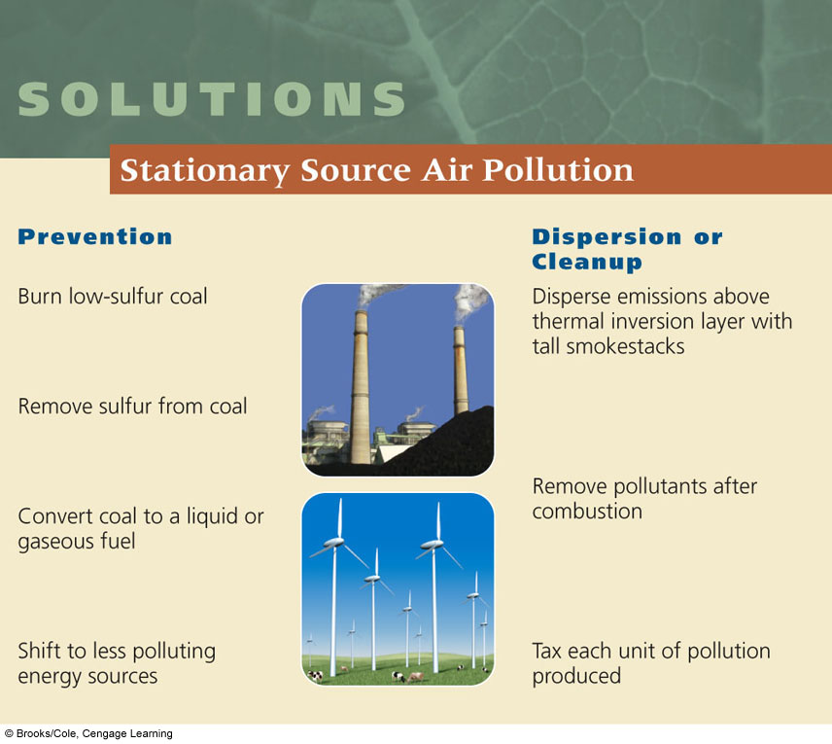
Solutions: Stationary Source Air Pollution

Slide 44
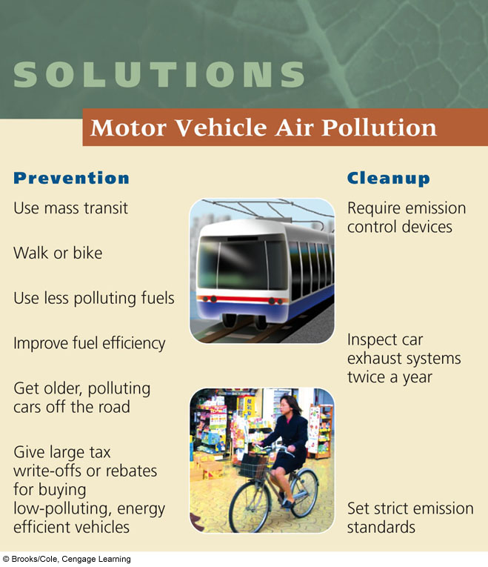
Solutions: Motor Vehicle Air Pollution, Prevention and Cleanup

Slide 45
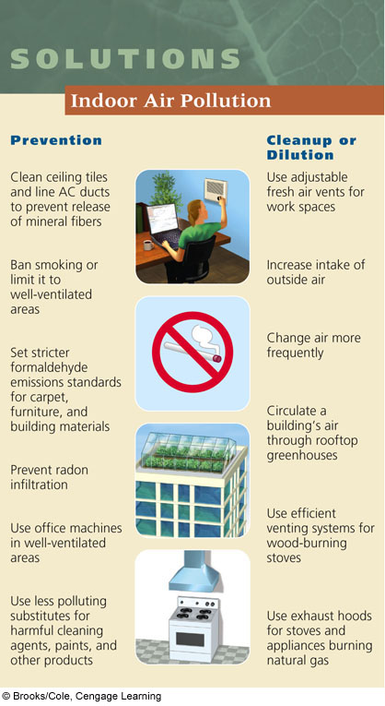
Solutions: Indoor Pollution, Prevention and Cleanup or Dilution

Slide 46
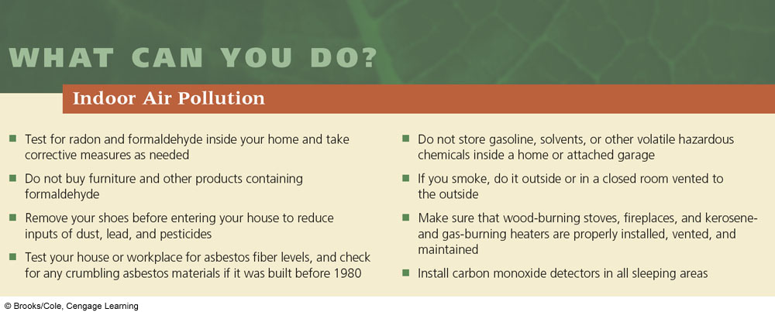
What Can You Do? Indoor Pollution: Ways to Reduce Your Exposure

Slide 47
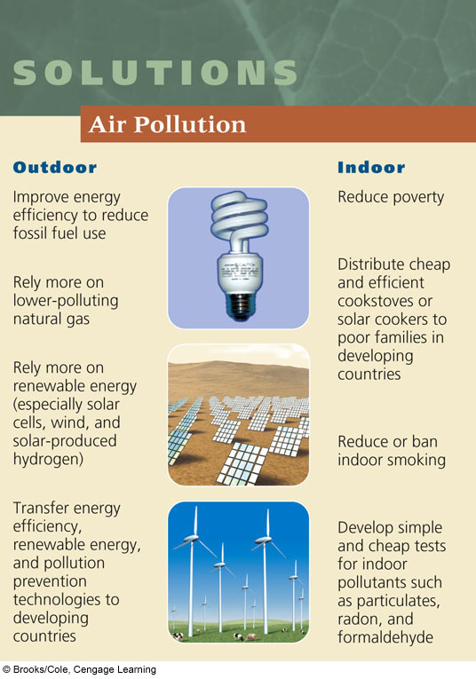
Solutions: Air Pollution

Slide 48
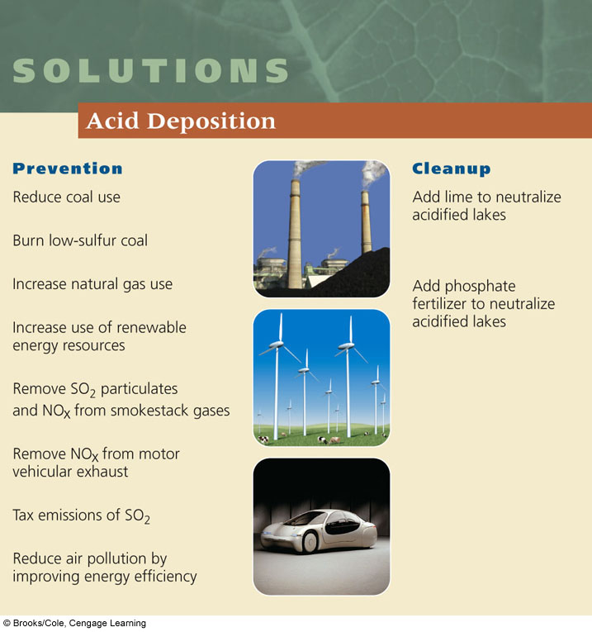
Solutions: Acid Deposition

Slide 49
Bangladesh Scenario
In Bangladesh the air pollution problem is more acute in areas where concentration of industries is more: Dhaka, Chittagong, Khulna, Narayanganj.
Apart from unplanned industrial development in these areas, the severity of the pollution is increased mainly due to exhausts from two-stroke engine and diesel-run vehicles.
In the rural areas of Bangladesh, the air pollution problems have not yet become a point of concern. This is due to fewer motorized vehicles and industries in rural areas.
However, in rural areas indoor air pollution from unhygienic kitchen is a severe source of air pollution problem for rural population of Bangladesh.

Slide 50
Bangladesh Scenario….
The other important type of air pollution source is the numerous brick-making kilns operated seasonally, mainly in dry season all over Bangladesh.
Almost all of these kilns use coal and wood as their prime sources of energy, resulting in the emission of particulate matter, oxides of sulfur, and volatile organic compounds.
The air pollution from these kilns is not only due to the type of fuel used, but also due to the thermal inefficiencies of the conventional kilns. This causes emissions like SOx, CO, particulate matters, and volatile organic compounds that deteriorate air quality.

Slide 51
How serious is the indoor air quality problem for poor families in Bangladesh?
Results for six Bangladeshi regions suggest that indoor PM₁₀ concentrations are quite high (European Union standard: 50 µg/m3) for many poor families.
 | Average PM₁₀ in Kitchen
Rural | 275 ug/m³
Peri-urban | 226 ug/m³
Urban | 193 ug/m³ ^{A WB Study}

